Slide 1



Noida Institute of Engineering and Technology, Greater Noida
Tree, Graph, Recurrence Relations and Combinatorics
Unit: 5
Discrete Structures & Theory of Logic
(KCS-303)
Mr. Gaurav Singhania
Asst. Prof., IT Dept.
Mr. Bhupendra Kr.
Asst. Prof., IT Dept.
Course Details
(Ex: B Tech 3rd Sem)
Mr. Gaurav Singhania, Mr. Bhupendra Kr. KCS-303 (DSTL) Unit 5

Slide 2
Course Objective (CO5)
A course discrete structures used to represent discrete objects and relationships between these objects. These discrete structures include sets, relation , permutations, relations, graphs and trees etc.
The subject enhances one’s ability to develop logical thinking and ability to problem solving.
Mr. Gaurav Singhania, Mr. Bhupendra Kr. KCS-303 (DSTL) Unit 5

Slide 3
Unit 5 Objectives
The objective of the course is to Explain basic concepts in combinatorial graph theory Define how graphs serve as models for many standard problems discuss the concept of graph, tree, Euler graph, cut set and Combinatorics. See the applications of graphs in science, business and industry.
Solve counting problems involving the multiplication rule, permutations, and combinations (with and without replacement). Use standard notation. Apply the Pigeonhole Principle. Use the basic ideas of discrete probability.
Mr. Gaurav Singhania, Mr. Bhupendra Kr. KCS-303 (DSTL) Unit 5

Slide 4
Course Outcome
Course Outcome ( CO) | At the end of course , the student will be able to understand | Bloom’s Knowledge Level (KL)
CO1 | Write an argument using logical notation and determine if the argument is or is not valid. | K3, K4
CO2 | Understand the basic principles of sets and operations in sets. | K1, K2
CO3 | Demonstrate an understanding of relations and functions and be able to determine their properties | K3
CO4 | Demonstrate different traversal methods for trees and graphs. | K1, K4
CO5 | Model problems in Computer Science using graphs and trees. | K2, K6
Mr. Gaurav Singhania, Mr. Bhupendra Kr. KCS-303 (DSTL) Unit 5

Slide 5
CO-PO’s and PSO’s Mapping
 | PO1 | PO2 | PO3 | PO4 | PO5 | PO6 | PO7 | PO8 | PO9 | PO10 | PO11 | PO12
KCS303.1 | 3 | 2 | 2 | - | - | 1 | - | - | - | 1 | 1 | 3
KCS303.2 | 3 | 3 | 2 | 2 | 1 | - | - | - | - | - | 2 | 1
KCS303.3 | 3 | 3 | 2 | 1 | - | - | 3 | - | 2 | 2 | 2 | 2
KCS303.4 | 3 | 3 | 2 | 1 | - | - | 1 | - | - | 3 | 2 | 2
KCS303.5 | 3 | 3 | 2 | 1 | - | - | 3 | - | - | 1 | 3 | 3
 | PSO1 | PSO2 | PSO3 | PSO4
KCS303.1 | 1 | 2 | 3 | -
KCS303.2 | 1 | 2 | 3 | 1
KCS303.3 | 3 | 2 | 3 | 1
KCS303.4 | 2 | 3 | 3 | -
KCS303.5 | 2 | 3 | 2
11/05/2020
Mr. Gaurav Singhania, Mr. Bhupendra Kr. KCS-303 (DSTL) Unit 5

Slide 6
Prerequisite & Recap (CO5)
Prerequisite
Basic Understanding of class 10 mathematics NCERT.
Basic Knowledge of sets and algebraic rules
Basic Understanding of Sets, Relations, Functions and Mathematical Induction, Algebraic Structures, Lattices and Boolean Algebra, & Propositions.
Recap
Now students are able to develop there logical thinking by using Sets, Relations, Functions and Mathematical Induction, Algebraic Structures, Lattices and Boolean Algebra, & Propositions concepts and use in upcoming topic. i.e. Tree, Graph, Recurrence Relations and Combinatorics.
Mr. Gaurav Singhania, Mr. Bhupendra Kr. KCS-303 (DSTL) Unit 5

Slide 7
Content (CO5)
Tree:
  Binary Tree
  Binary Search Tree
  Binary tree traversal
Graphs
Recurrence Relations
  Linear Recurrence Relation
  Linear homogeneous recurrences
  Linear non-homogeneous recurrences
Combinatorics
  Pigeonhole Principle
Mr. Gaurav Singhania, Mr. Bhupendra Kr. KCS-303 (DSTL) Unit 5

Slide 8
Topic Objectives: Trees (CO 5)
Trees are mainly used to represent data containing a hierarchical relationship between elements, for example, records, family trees and table of contents
Given a binary tree and a node, find the left and right children of that node and the left and right subtrees at those children.
Mr. Gaurav Singhania, Mr. Bhupendra Kr. KCS-303 (DSTL) Unit 5

Slide 9
Topic Prerequisite & Recap (CO5)
Prerequisite
Basic Understanding of class 10 mathematics NCERT.
Basic Knowledge of sets and algebraic rules
Basic Understanding of Sets, Relations, Functions and Mathematical Induction, Algebraic Structures, Lattices and Boolean Algebra, & Propositions.
Recap
Now students are able to develop there logical thinking by using Sets, Relations, Functions and Mathematical Induction, Algebraic Structures, Lattices and Boolean Algebra, & Propositions concepts and use in upcoming topic. i.e. Tree.
Mr. Gaurav Singhania, Mr. Bhupendra Kr. KCS-303 (DSTL) Unit 5

Slide 10
Introduction to trees(CO 5)
Trees are mainly used to represent data containing a hierarchical relationship between elements, for example, records, family trees and table of contents
Mr. Gaurav Singhania, Mr. Bhupendra Kr. KCS-303 (DSTL) Unit 5

Slide 11
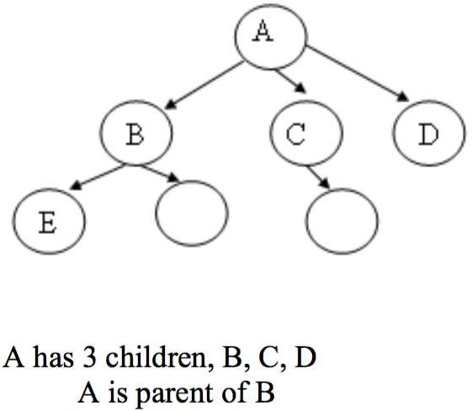
TREE(CO 5)
A tree is an abstract model of a hierarchical structure that consists of nodes with a parent-child relationship.
  Tree is a sequence of nodes
  There is a starting node known as a root node
  Every node other than the root has a parent node.
  Nodes may have any number of children
Mr. Gaurav Singhania, Mr. Bhupendra Kr. KCS-303 (DSTL) Unit 5

Slide 12
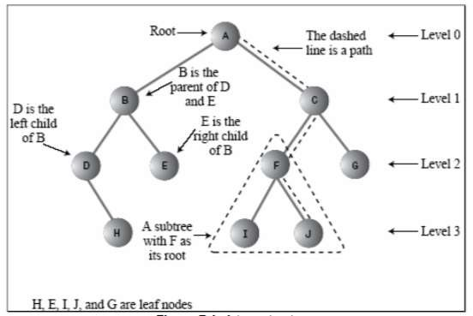
Tree(CO 5)
Mr. Gaurav Singhania, Mr. Bhupendra Kr. KCS-303 (DSTL) Unit 5

Slide 13
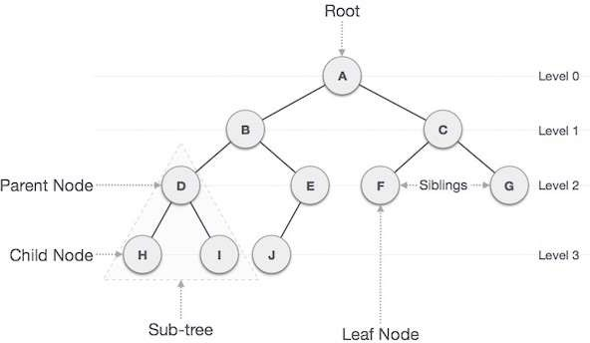
TREE(CO 5)
Mr. Gaurav Singhania, Mr. Bhupendra Kr. KCS-303 (DSTL) Unit 5

Slide 14
Some Key Terms(CO 5)
Root − Node at the top of the tree is called root.
Parent − Any node except root node has one edge upward to a node called parent.
Child − Node below a given node connected by its edge downward is called its child node.
Sibling – Child of same node are called siblings
Leaf − Node which does not have any child node is called leaf node.
Sub tree − Sub tree represents descendants of a node.
Mr. Gaurav Singhania, Mr. Bhupendra Kr. KCS-303 (DSTL) Unit 5

Slide 15
Some Key Terms(CO 5)
Levels − Level of a node represents the generation of a node. If root node is at level 0, then its next child node is at level 1, its grandchild is at level 2 and so on.
keys − Key represents a value of a node based on which a search operation is to be carried out for a node.
Mr. Gaurav Singhania, Mr. Bhupendra Kr. KCS-303 (DSTL) Unit 5

Slide 16
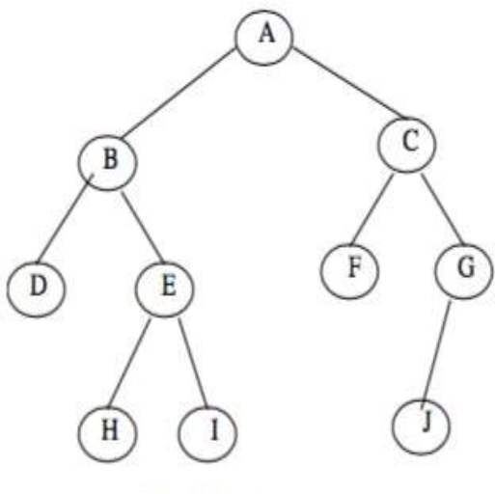
Introduction To Binary Trees (CO 5)
A binary tree, is a tree in which no node can have more than two children.
Consider a binary tree T, here ‘A’ is the root node of the binary tree T.
B’ is the left child of ‘A’ and ‘C’ is the right child of ‘A’
  i.e A is a father of B and C.
  The node B and C are called siblings.
Mr. Gaurav Singhania, Mr. Bhupendra Kr. KCS-303 (DSTL) Unit 5

Slide 17
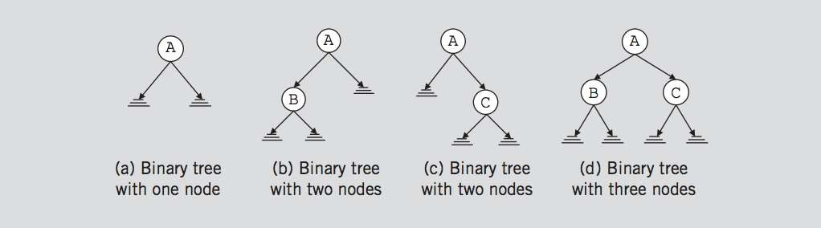
Binary Trees(CO 5)
A binary tree, T, is either empty or such that
T has a special node called the root node
T has two sets of nodes L_{T} and R_{T}, called the left subtree and right subtree of
T, respectively.
L_{T} and R_{T} are binary trees.
Mr. Gaurav Singhania, Mr. Bhupendra Kr. KCS-303 (DSTL) Unit 5

Slide 18
Binary Tree(CO 5)
A binary tree is a finite set of elements that are either empty or is partitioned into three disjoint subsets.
The first subset contains a single element called the root of the tree.
The other two subsets are themselves binary trees called the left and right sub-trees of the original tree.
A left or right sub-tree can be empty.
Each element of a binary tree is called a node of the tree.
Mr. Gaurav Singhania, Mr. Bhupendra Kr. KCS-303 (DSTL) Unit 5

Slide 19
Binary Tree Properties(CO 5)
If a binary tree contains m nodes at level L, it contains at most 2m nodes at level L+1
Since a binary tree can contain at most 1 node at level 0 (the root), it contains at most 2L nodes at level L.
Mr. Gaurav Singhania, Mr. Bhupendra Kr. KCS-303 (DSTL) Unit 5

Slide 20
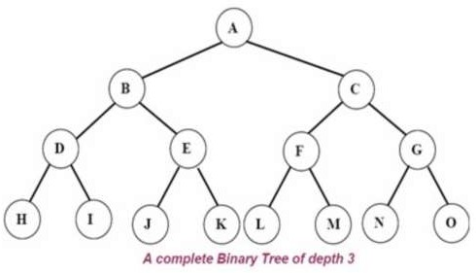
Complete binary tree(CO 5)
A complete binary tree is a binary tree in which every level, except possibly the last, is completely filled, and all nodes are as far left as possible.
A complete binary tree of depth d is called strictly binary tree if all of whose leaves are at level d.
A complete binary tree has 2^{d} nodes at every depth d and 2^{d} -1 non leaf nodes
Mr. Gaurav Singhania, Mr. Bhupendra Kr. KCS-303 (DSTL) Unit 5

Slide 21
Tree traversal(CO 5)
Traversal is a process to visit all the nodes of a tree and may print their values too.
All nodes are connected via edges (links) we always start from the root (head) node.
There are three ways which we use to traverse a tree
  In-order Traversal
  Pre-order Traversal
  Post-order Traversal
Generally we traverse a tree to search or locate given item or key in the tree or to print all the values it contains.
Mr. Gaurav Singhania, Mr. Bhupendra Kr. KCS-303 (DSTL) Unit 5

Slide 22
Pre-order, In-order, Post-order(CO 5)
Pre-order
<root><left><right>
In-order
<left><root><right>
Post-order
<left><right><root>
Mr. Gaurav Singhania, Mr. Bhupendra Kr. KCS-303 (DSTL) Unit 5

Slide 23
Binary Search Tree(BST) (CO 5)
A binary search tree (BST) is a binary tree that is either empty or in which every node contains a key (value) and satisfies the following conditions:
  All keys in the left sub-tree of the root are smaller than the key in the root node
  All keys in the right sub-tree of the root are greater than the key in the root node
  The left and right sub-trees of the root are again binary search trees
Mr. Gaurav Singhania, Mr. Bhupendra Kr. KCS-303 (DSTL) Unit 5

Slide 24
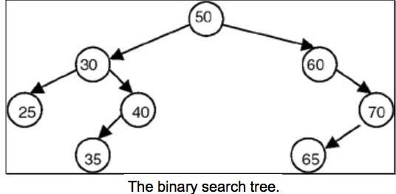
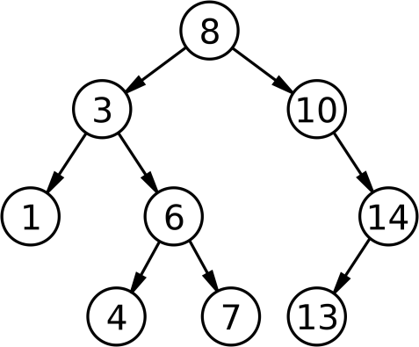
Binary Search Tree(BST) (CO 5)
Mr. Gaurav Singhania, Mr. Bhupendra Kr. KCS-303 (DSTL) Unit 5

Slide 25
Binary Search Tree (BST) (CO 5)
A binary search tree is basically a binary tree, and therefore it can be traversed in inorder, preorder and postorder.
If we traverse a binary search tree in inorder and print the identifiers contained in the nodes of the tree, we get a sorted list of identifiers in ascending order.
Mr. Gaurav Singhania, Mr. Bhupendra Kr. KCS-303 (DSTL) Unit 5

Slide 26
Operations on Binary Search Tree (BST) (CO 5)
Following operations can be done in BST:
  Search(k, T): Search for key k in the tree T. If k is found in some node of tree then return true otherwise return false.
  Insert(k, T): Insert a new node with value k in the info field in the tree T such
that the property of BST is maintained.
  Delete(k, T):Delete a node with value k in the info field from the tree T such that the property of BST is maintained.
  FindMin(T), FindMax(T): Find minimum and maximum element from the given nonempty BST.
Mr. Gaurav Singhania, Mr. Bhupendra Kr. KCS-303 (DSTL) Unit 5

Slide 27
Binary Search Tree(BST) (CO 5)
Time Complexity
 | Array | Linked List | BST
Search | O(n) | O(n) | O(logn)
Insert | O(1) | O(1) | O(logn)
Remove | O(n) | O(n) | O(logn)
Mr. Gaurav Singhania, Mr. Bhupendra Kr. KCS-303 (DSTL) Unit 5

Slide 28
Topic Objectives: Graph Theory(CO 5)
The student will demonstrate the ability to use a problem-solving approach to model practical problems using graphs and circuits.
The student will be able to:
  determine whether a graph is planar or nonplanar
  describe cyclic graphs, null graphs, and complete graphs with v vertices
  determine the valence (degree) and connectedness of a graph
  determine whether a graph has an Euler Circuit or Path, and if so, find it
  determine whether a graph has a Hamilton Circuit or Path, and if so, find it
  determine the number of Hamilton Circuits for a complete graph with n vertices
Mr. Gaurav Singhania, Mr. Bhupendra Kr. KCS-303 (DSTL) Unit 5

Slide 29
Topic Prerequisite & Recap (CO5)
Prerequisite
Basic Understanding of class 10 mathematics NCERT.
Basic Knowledge of sets and algebraic rules
Basic Understanding of Sets, Relations, Functions and Mathematical Induction, Algebraic Structures, Lattices and Boolean Algebra, & Propositions.
Recap
Now students are able to develop there logical thinking by using Sets, Relations, Functions and Mathematical Induction, Algebraic Structures, Lattices and Boolean Algebra, Propositions & Tree concepts and use in upcoming topic. i.e. Graph Theory.
Mr. Gaurav Singhania, Mr. Bhupendra Kr. KCS-303 (DSTL) Unit 5

Slide 30
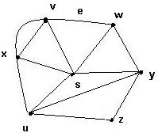
Graph Theory(CO 5)
What is a graph G?
In discrete mathematics, a graph is a collection of points, called vertices, and lines between those points, called edges.
It is a pair G = (V, E), where
V = V(G) = set of vertices
E = E(G) = set of edges
Example:
V = {s, u, v, w, x, y, z}
E = {(x,s), (x,v), (x,v), (x,u),
(v,w), (s,v), (s,u), (s,w), (s,y),
(w,y), (u,y), (u,z),(y,z)}
Mr. Gaurav Singhania, Mr. Bhupendra Kr. KCS-303 (DSTL) Unit 5

Slide 31
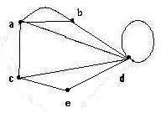
Special edges(CO 5)
Parallel edges
Two or more edges joining a pair of vertices
    in the example, a and b are joined by two parallel edges
Loops
An edge that starts and ends at the same vertex
In the example, vertex d has a loop
Mr. Gaurav Singhania, Mr. Bhupendra Kr. KCS-303 (DSTL) Unit 5

Slide 32
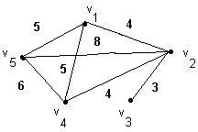
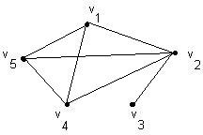
Special graphs (CO 5)
Simple graph
    A graph without loops or parallel edges.
Weighted graph
  A graph where each edge is assigned a numerical label or “weight”.
Mr. Gaurav Singhania, Mr. Bhupendra Kr. KCS-303 (DSTL) Unit 5

Slide 33
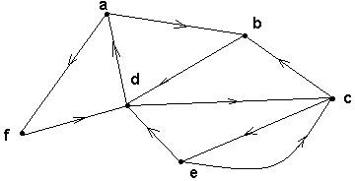
Directed graphs(Digraph) (CO 5)
G is a directed graph or digraph if each edge has been associated with an ordered pair of vertices, i.e. each edge has a direction
Mr. Gaurav Singhania, Mr. Bhupendra Kr. KCS-303 (DSTL) Unit 5

Slide 34
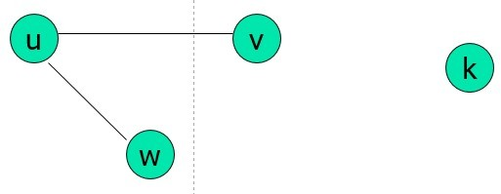
Terminology – Undirected graphs(CO 5)
u and v are adjacent if {u, v} is an edge, e is called incident with u and v. u and v are called endpoints of {u, v}
Degree of Vertex (deg (v)): the number of edges incident on a vertex. A loop contributes twice to the degree (why?).
Pendant Vertex: deg (v) =1
Isolated Vertex: deg (v) = 0
Representation Example: For V = {u, v, w} , E = { {u, w}, {u, w}, (u,v) }, deg (u) = 2, deg (v) = 1, deg (w) = 1, deg (k) = 0, w and v are pendant , k is isolated
Mr. Gaurav Singhania, Mr. Bhupendra Kr. KCS-303 (DSTL) Unit 5

Slide 35
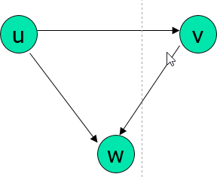
Terminology – Undirected graphs(CO 5)
For the edge (u, v), u is adjacent to v OR v is adjacent from u, u – Initial vertex, v – Terminal vertex
In-degree (deg⁻ (u)): number of edges for which u is terminal vertex
Out-degree (deg⁺ (u)): number of edges for which u is initial vertex
Note: A loop contributes 1 to both in-degree and out-degree (why?)
Representation Example: For V = {u, v, w} , E = { (u, w), ( v, w), (u, v) }, deg⁻ (u) = 0, deg⁺ (u) = 2, deg⁻ (v) = 1,
deg⁺ (v) = 1, and deg⁻ (w) = 2, deg⁺ (u) = 0
Mr. Gaurav Singhania, Mr. Bhupendra Kr. KCS-303 (DSTL) Unit 5

Slide 36
Theorems: Undirected Graphs(CO 5)
Theorem 1
The Handshaking theorem:
2e =∑v
v∈V
(why?) Every edge connects 2 vertices
Mr. Gaurav Singhania, Mr. Bhupendra Kr. KCS-303 (DSTL) Unit 5

Slide 37
Theorems: Undirected Graphs(CO 5)
Theorem 2:
An undirected graph has even number of vertices with odd degree
Pr oof V1 is the set of even degree vertices and V2 refers to odd degree vertices 2e   deg(v)  deg(u)  deg(v)
vV u V1 vV2
deg (v) is even for vV1,
The first term in the right hand side of the last inequality is even.
The sum of the last two terms on the right hand side of the last inequality is even since sum is 2e.
Hence second term is also even
second term deg(v)  even
vV2
Mr. Gaurav Singhania, Mr. Bhupendra Kr. KCS-303 (DSTL) Unit 5

Slide 38
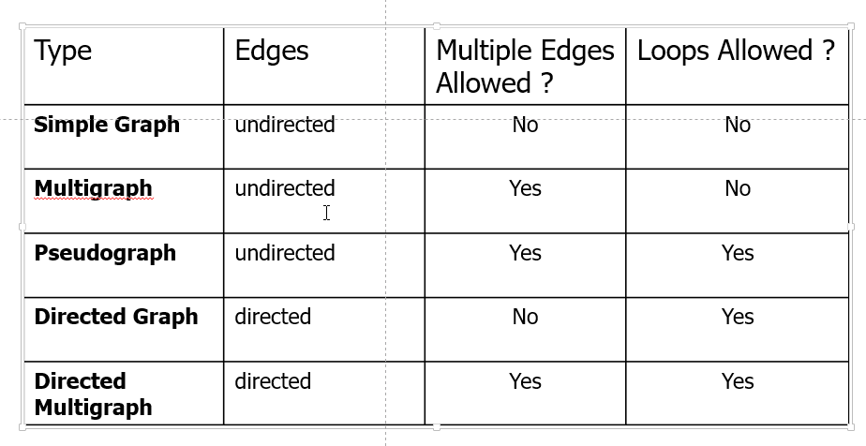
Definitions – Graph Type(CO 5)
Mr. Gaurav Singhania, Mr. Bhupendra Kr. KCS-303 (DSTL) Unit 5

Slide 39
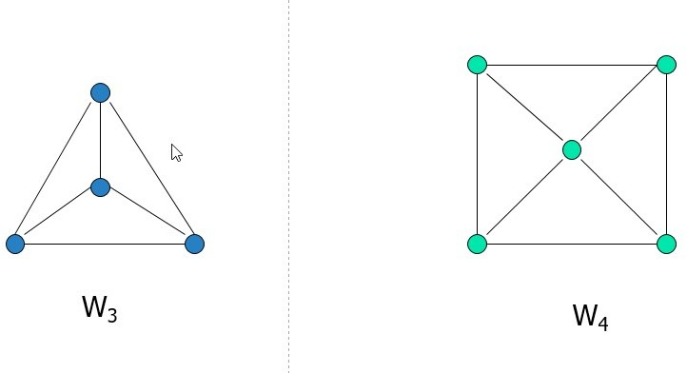
Simple graphs – special cases(CO 5)
Wheels: W_{n}, obtained by adding additional vertex to Cn and connecting all vertices to this new vertex by new edges.
Representation Example: W₃, W₄
Mr. Gaurav Singhania, Mr. Bhupendra Kr. KCS-303 (DSTL) Unit 5

Slide 40
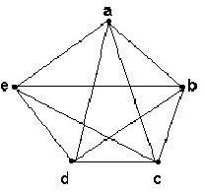
Complete graph K _{n}(CO 5)
Let n > 3
The complete graph K_{n} is the graph with n vertices and every pair of vertices is joined by an edge.
The figure represents K₅
Mr. Gaurav Singhania, Mr. Bhupendra Kr. KCS-303 (DSTL) Unit 5

Slide 41
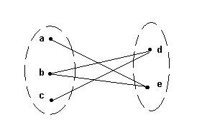
Bipartite graphs(CO 5)
A bipartite graph G is a graph such that
■ V(G) = V(G₁)  V(G₂)
■ |V(G₁)| = m, |V(G₂)| = n
■ V(G₁) V(G₂) = 
■ No edges exist between any two vertices in the same subset V(G_{k}), k = 1,2
Mr. Gaurav Singhania, Mr. Bhupendra Kr. KCS-303 (DSTL) Unit 5

Slide 42
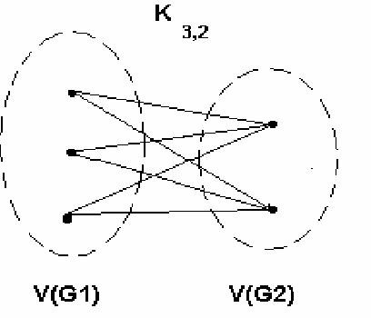
Complete bipartite graph K_{m,n}(CO 5)
A bipartite graph is the
complete bipartite graph K_{m,n} if
every vertex in V(G₁) is joined to a vertex in V(G₂) and
conversely,
|V(G₁)| = m
|V(G₂)| = n
Mr. Gaurav Singhania, Mr. Bhupendra Kr. KCS-303 (DSTL) Unit 5

Slide 43
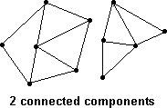
Connected graphs(CO 5)
A graph is connected if every pair of vertices can be connected by a path
Each connected subgraph of a non- connected graph G is called a component of G
Mr. Gaurav Singhania, Mr. Bhupendra Kr. KCS-303 (DSTL) Unit 5

Slide 44
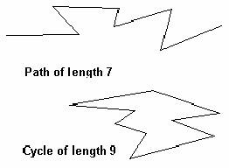
Paths and cycles(CO 5)
A path of length n is a sequence of n + 1 vertices and n consecutive edges
A cycle is a path that begins and ends at the same vertex
Mr. Gaurav Singhania, Mr. Bhupendra Kr. KCS-303 (DSTL) Unit 5

Slide 45
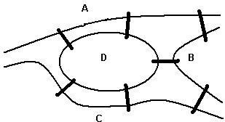
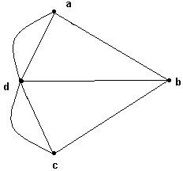
Euler cycles(CO 5)
An Euler cycle in a graph G is a simple cycle that passes through every edge of G only once.
The Konigsberg bridge problem:
Starting and ending at the same point, is it possible to cross all seven bridges just once and return to the starting point?
This problem can be represented by a graph
Edges represent bridges and each vertex represents a region
Mr. Gaurav Singhania, Mr. Bhupendra Kr. KCS-303 (DSTL) Unit 5

Slide 46
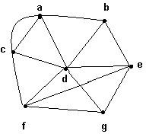
Degree of a vertex(CO 5)
The degree of a vertex v, denoted by δ(v), is the number of edges incident on v
Example:
(a) = 4, δ(b) = 3,
■ c) = 4, δ(d) = 6,
(e) = 4, δ(f) = 4,
(g) = 3.
Mr. Gaurav Singhania, Mr. Bhupendra Kr. KCS-303 (DSTL) Unit 5

Slide 47
Sum of the degrees of a graph(CO 5)
Theorem : If G is a graph with m edges and n vertices v₁, v₂,…, v_{n}, the
 (v_{i}) = 2m
In particular, the sum of the degrees of all the vertices of a graph is even.
Mr. Gaurav Singhania, Mr. Bhupendra Kr. KCS-303 (DSTL) Unit 5

Slide 48
Topic Prerequisite & Recap (CO5)
Prerequisite
Basic Understanding of class 10 mathematics NCERT.
Basic Knowledge of sets and algebraic rules
Basic Understanding of Sets, Relations, Functions and Mathematical Induction, Algebraic Structures, Lattices and Boolean Algebra, & Propositions, Tree & Graph Theory.
Recap
Now students are able to develop there logical thinking by using Sets, Relations, Functions and Mathematical Induction, Algebraic Structures, Lattices and Boolean Algebra, Propositions, Tree & Graph Theory concepts and use in upcoming topic. i.e., Recurrence Relations.
Mr. Gaurav Singhania, Mr. Bhupendra Kr. KCS-303 (DSTL) Unit 5

Slide 49
Recurrence Relation(CO 5)
A recurrence relation is an equation that recursively defines a sequence where the next term is a function of the previous terms (Expressing Fn as some combination of Fi with i<n).
Example 1 Fibonacci series F_{n} = F_{n−1}+ F_{n−2}
Example 2 a_{n} = a_{n−1}+ 2 with a₀ = 1
₋
Mr. Gaurav Singhania, Mr. Bhupendra Kr. KCS-303 (DSTL) Unit 5

Slide 50
Linear Recurrence Relation(CO 5)
A linear recurrence equation of degree k or order k is a recurrence equation which is in the format
x_{n} = A₁x_{n−1}+A₂x_{n−2}+A₃x_{n−3}+…..+A_{k}x_{n - k} (A_{n} is a constant and A_{k}≠0) on a sequence of numbers as a first-degree polynomial.
Each term of a sequence is a linear function of earlier terms in the sequence.
For example: a0 = 1 a1 = 6 a2 = 10
an = an−1 + 2 an−2 + 3 an−2
a3 = a0 + 2a1 + 3a2
= 1 + 2(6) + 3(10) = 43
Mr. Gaurav Singhania, Mr. Bhupendra Kr. KCS-303 (DSTL) Unit 5

Slide 51
Linear Recurrence Relation(CO 5)
Linear recurrences has following types
Linear homogeneous recurrences
Linear non-homogeneous recurrences
Mr. Gaurav Singhania, Mr. Bhupendra Kr. KCS-303 (DSTL) Unit 5

Slide 52
Linear homogeneous recurrences(CO 5)
A linear homogenous recurrence relation of degree k with constant coefficients is a recurrence relation of the form
an = c1 an-1 + c2 an-2 + … + ck an-k,
where c1, c2, …, ck are real numbers, and ck ≠ 0.
an is expressed in terms of the previous k terms of the sequence, so its degree is k. This recurrence includes k initial conditions.
a0 = C0 a1 = C1 ……………………… ak = Ck
Mr. Gaurav Singhania, Mr. Bhupendra Kr. KCS-303 (DSTL) Unit 5

Slide 53
Linear homogeneous recurrences(CO 5)
Example
Determine if the following recurrence relations are linear homogeneous recurrence relations with constant coefficients.
Example 1_x0001_ Pn = (1.11) Pn-1 a linear homogeneous recurrence relation of degree one _x0001_
Example 2 fn = fn-1 + fn-2 a linear homogeneous recurrence relation of degree two
_x0001_
Mr. Gaurav Singhania, Mr. Bhupendra Kr. KCS-303 (DSTL) Unit 5

Slide 54
Solution of linear Recurrence Relation(CO 5)
We can find any solution of the form an = r^{n} that satisfies the recurrence relation.
Recurrence relation are given in that form
an = c1 an-1 + c2 an-2 + …………………. + ckan-k
Put the values an = r^{n} in above recurrence relation
r^{n} = c₁r^{n-1} - c₂r^{n-2} - … - c_{k}r^{n-k}
r^{n} - c₁r^{n-1} - c₂r^{n-2} - … - c_{k}r^{n-k} = 0
Mr. Gaurav Singhania, Mr. Bhupendra Kr. KCS-303 (DSTL) Unit 5

Slide 55
Solution of linear Recurrence Relation(CO 5)
dividing both sides by r^{n-k}
r^{k} - c₁r^{k-1} - c₂r^{k-2} - … - c_{k} = 0
This equation is called the characteristic equation.
Its example characteristic equation is r² - r - 1 = 0
Mr. Gaurav Singhania, Mr. Bhupendra Kr. KCS-303 (DSTL) Unit 5

Slide 56
Solution of linear Recurrence Relation(CO 5)
Question1 What is the solution of the recurrence relation
a_{n} = a_{n-1} + 2a_{n-2} with a₀=2 and a₁=7?
Solution: _x0001_ Since it is linear homogeneous recurrence, first find its characteristic equation
r² - r - 2 = 0
(r+1)(r-2) = 0
r₁ = 2 and r₂ = -1
_x0001_
So, a_{n} = A2^{n} + B(-1)^{n} is a solution.
_x0001_
Mr. Gaurav Singhania, Mr. Bhupendra Kr. KCS-303 (DSTL) Unit 5

Slide 57
Solution of linear Recurrence Relation(CO 5)
Now we should find A and B using initial conditions.
Put n = 0 and 1 in above equation
a₀ = A + B = 2
a₁ = 2A - B = 7
Solve above these equation A = 3 and B = -1
a_{n} = 3.2^{n} - (-1)^{n} is a solution.
Mr. Gaurav Singhania, Mr. Bhupendra Kr. KCS-303 (DSTL) Unit 5

Slide 58
Solution of linear Recurrence Relation(CO 5)
Question 2 What is the solution of the recurrence relation
a_{n} = 6a_{n-1} - 9a_{n-2} with a₀=1 and a1=6?
Solution: _x0001_ First find its characteristic equation
r² - 6r + 9 = 0
(r - 3)² = 0 r₁ = 3
_x0001_
So, by theorem a_{n} = (A + Bn) (3)^{n} is a solution. _x0001_
Now we should find constants using initial conditions.
A = 1 and B= 1_x0001_
a_{n} = 3^{n} + n3^{n} is a solution.
Mr. Gaurav Singhania, Mr. Bhupendra Kr. KCS-303 (DSTL) Unit 5

Slide 59
Solution of linear Recurrence Relation(CO 5)
Question 3 What is the solution of the recurrence relation
a_{n} = -3a_{n-1} - 3a_{n-2} - a_{n-3} with a₀=1, a₁=-2 and a₂=-1?
Solution Find its characteristic equation
r³ + 3r² + 3r + 1 = 0
(r + 1)³ = 0 then r₁= -1 _x0001_
Then an = (A + B n + Cn²)(-1)^{n} is a solution. _x0001_
Now we should find constants using initial conditions. And find the value of A, B and C
A = 1 B = 3 C = -2
Then put the value of A, B and C in above equation
_x0001_ a_{n} = (1 + 3n - 2n²) (-1)^{n} is a solution.
Mr. Gaurav Singhania, Mr. Bhupendra Kr. KCS-303 (DSTL) Unit 5

Slide 60
Solution of linear Recurrence Relation(CO 5)
Question 4 What is the solution of the recurrence relation
a_{n} = 8a_{n-2} - 16a_{n-4} , for n>=4,
with a₀=1, a₁=4, a₂=28 and a₃=32?
Solution: Find its characteristic equation
r⁴ - 8r² + 16 = 0
(r² - 4)² = (r-2)² (r+2)² = 0
r₁ = 2 and r₂ = -2
a_{n} = (A + Bn)(2)^{n} + (C + Dn)(-2)^{n} is a solution.
Mr. Gaurav Singhania, Mr. Bhupendra Kr. KCS-303 (DSTL) Unit 5

Slide 61
Solution of linear Recurrence Relation(CO 5)
Now we should find constants using initial conditions.
A = 1, B = 2, C = 0 and D = 1
a_{n} = (1 + 2n) 2^{n} + n (-2)^{n} is a solution.
Mr. Gaurav Singhania, Mr. Bhupendra Kr. KCS-303 (DSTL) Unit 5

Slide 62
Linear non-homogeneous recurrences(CO 5)
A linear non-homogenous recurrence relation with constant coefficients is a recurrence relation of the form
a_{n} = c₁ a_{n-1} + c₂ a_{n-2} + ………….. + c_{k} a_{n-k}+ f(n)
where c₁, c₂, …….., c_{k} are real numbers, and f(n) is a function depending only on n.
The recurrence relation
a_{n} = c₁ a_{n-1} + c₂ a_{n-2} + ………….. + c_{k} a_{n-k} is called the associated homogeneous recurrence relation.
This recurrence includes k initial conditions.
a₀ = C₀ a₁ = C₁… a_{k} = C_{k}
Mr. Gaurav Singhania, Mr. Bhupendra Kr. KCS-303 (DSTL) Unit 5

Slide 63
Linear non-homogeneous recurrences(CO 5)
The following recurrence relations are linear non homogeneous
recurrence relations.
Example 1 a_{n} = a_{n-1} + 2^{n}
Example 2 a_{n} = a_{n-1} + a_{n-2} + n² + n + 1
Example 3 a_{n} = a_{n-1} + a_{n-4} + n!
Example 4 a_{n} = a_{n-6} + n2^{n}
Mr. Gaurav Singhania, Mr. Bhupendra Kr. KCS-303 (DSTL) Unit 5

Slide 64
Linear non-homogeneous recurrences(CO 5)
Q1 What is the solution of the recurrence relation
a_{n} = 2a_{n-1} - a_{n-2} + 2^{n} for n>=2,
with a₀=1 and a₁=2?
Solution: Since it is linear non-homogeneous recurrence, b_{n}
is similar to f(n) then b_{n} = c2^{n} + d
b_{n} = 2b_{n-1} - b_{n-2} + 2^{n}
c2^{n} + d = 2(c2^{n-1} + d) - (c2^{n-2} + d) + 2n
c2^{n} + d = c2^{n} + 2d - c2^{n-2} - d + 2n
Mr. Gaurav Singhania, Mr. Bhupendra Kr. KCS-303 (DSTL) Unit 5

Slide 65
Linear non-homogeneous recurrences(CO 5)
0 = (-4c + 4c - c + 4)2^{n-2} + (-d + 2d -d)
c = 4 and d=0
then b_{n} = 4.2^{n}.
Mr. Gaurav Singhania, Mr. Bhupendra Kr. KCS-303 (DSTL) Unit 5

Slide 66
Topic Prerequisite & Recap (CO5)
Prerequisite
Basic Understanding of class 10 mathematics NCERT.
Basic Knowledge of sets and algebraic rules
Basic Understanding of Sets, Relations, Functions and Mathematical Induction, Algebraic Structures, Lattices and Boolean Algebra, & Propositions Tree, Graph & Recurrence Relations .
Recap
Now students are able to develop there logical thinking by using Sets, Relations, Functions and Mathematical Induction, Algebraic Structures, Lattices and Boolean Algebra, Propositions Tree, Graph & Recurrence Relations concepts and use in upcoming topic. i.e. Combinatorics (Counting Theory).
Mr. Gaurav Singhania, Mr. Bhupendra Kr. KCS-303 (DSTL) Unit 5

Slide 67
Pigeonhole Principle(CO 5)
In 1834, German mathematician, Peter Gustav Lejeune Dirichlet, stated a principle which he called the drawer principle. Now, it is known as the pigeonhole principle.
Pigeonhole Principle states that if there are fewer pigeon holes than total number of pigeons and each pigeon is put in a pigeon hole, then there must be at least one pigeon hole with more than one pigeon. If n pigeons are put into m pigeonholes where n > m, there's a hole with more than one pigeon.
Mr. Gaurav Singhania, Mr. Bhupendra Kr. KCS-303 (DSTL) Unit 5

Slide 68
Pigeonhole Principle(CO 5)
Suppose that there are 10 pigeons, and there are 9 pigeonholes
In the evening, each pigeon will pick one of the pigeonholes to stay
In one of the pigeonholes, there will be at least two pigeons
If k is a positive integer and k + 1 objects are placed into k boxes, then at least one of the boxes will contain two ore more objects
Mr. Gaurav Singhania, Mr. Bhupendra Kr. KCS-303 (DSTL) Unit 5

Slide 69
Pigeonhole Principle(CO 5)
Example – 1: A bag contains 10 red marbles, 10 white marbles, and 10 blue marbles. What is the minimum no. of marbles you have to choose randomly from the bag to ensure that we get 4 marbles of same color?
Solution: Apply pigeonhole principle.
No. of colors (pigeonholes) n = 3
No. of marbles (pigeons) K+1 = 4
Therefore the minimum no. of marbles required = Kn+1
By simplifying we get Kn+1 = 10.
Verification: ceil[Average] is [Kn+1/n] = 4
[Kn+1/3] = 4
Kn+1 = 10
i.e., 3 red + 3 white + 3 blue + 1(red or white or blue) = 10
Mr. Gaurav Singhania, Mr. Bhupendra Kr. KCS-303 (DSTL) Unit 5

Slide 70
Pigeonhole Principle(CO 5)
Example – 2: In a computer science department, a student club can be formed with either 10 members from first year or 8 members from second year or 6 from third year or 4 from final year. What is the minimum no. of students we have to choose randomly from department to ensure that a student club is formed?
Solution: we can directly apply from the above formula where,
q₁ =10, q₂ =8, q₃ =6, q₄ =4 and n=4
Therefore the minimum number of students required to ensure department club to be formed is
10 + 8 + 6 + 4 – 4 + 1 = 25
Mr. Gaurav Singhania, Mr. Bhupendra Kr. KCS-303 (DSTL) Unit 5

Slide 71
Pólya’s Counting Theory(CO 5)
George Polya discovered a powerful general method for enumerating the number of orbits of a group on particular configurations. This method became known as the Polya Enumeration Theorem.
Suppose that a finite group G acts on a finite set X. Then the number of colorings of X in n colors in equivalent under the action of G is N(n) = 1 |G| X g∈G n c(g) where c(g) is the number of cycles of g as a permutation of X.
Mr. Gaurav Singhania, Mr. Bhupendra Kr. KCS-303 (DSTL) Unit 5

Slide 72
Faculty Video Links, Youtube & NPTEL Video Links and Online Courses Details (CO 5)
Youtube/other Video Links
https://www.youtube.com/watch?v=Dsi7x-A89Mw&list=PL0862D1A94725 2D20&index=28
https://www.youtube.com/watch?v=74l6t4_4pDg&list=PL0862D1A947252D20&index=29
https://www.youtube.com/watch?v=4d2XEn1j_q4&list=PL0862D1A947252D20&index=30
https://www.youtube.com/watch?v=qvw1GX93JSY&list=PL0862D1A947252D20&index=32
https://www.youtube.com/watch?v=ImLM1Vsr35c&list=PL0862D1A947252D20&index=33
Mr. Gaurav Singhania, Mr. Bhupendra Kr. KCS-303 (DSTL) Unit 5

Slide 73
Daily Quiz(CO 5)
Q1 Consider the recurrence relation a₁=4, a_{n}=5n+a_{n-1}. The value of a₆₄ is _________
(a) 10399 (b) 23760 (c) 75100 (d) 53700
Q2 Determine the solution of the recurrence relation
F_{n} = 20F_{n-1} − 25F_{n-2} where F₀ = 4 and F₁ =14.
(a) a_{n} = 14*5^{n-1}
(b) a_{n} = 7/2*2^{n}−1/2*6^{n}
(c) a_{n} = 7/2*2^{n}−3/4*6^{n+1}
(d) a_{n} = 3*2^{n}−1/2*3^{n}
Q3 Find the value of a₄ for the recurrence relation a_{n}=2a_{n-1}+3, with a₀=6.
(a) 320 (b) 221 (c) 141 (d) 65
Mr. Gaurav Singhania, Mr. Bhupendra Kr. KCS-303 (DSTL) Unit 5

Slide 74
Daily Quiz(CO 5)
Q4 The solution to the recurrence relation a_{n}=a_{n-1}+2n, with initial term a₀=2 are _________
(a) 4n+7 (b) 2(1+n) (c) 3n² (d) 5*(n+1)/2
Q5 What is the solution to the recurrence relation a_{n}=5a_{n-1}+6a_{n-2}?
(a) 2n² (b) 6n (c) (3/2)n (d) n!*3
Q6 Determine the value of a2 for the recurrence relation
a_{n} = 17a_{n-1} + 30n with a₀=3.
(a) 4387 (b) 5484 (c) 238 (d) 1437
Q7 Determine the solution for the recurrence relation
a_{n} = 6a_{n-1}−8a_{n-2} provided initial conditions a₀=3 and a₁=5.
(a) a_{n} = 4 * 2^{n} – 3^{n}
(b) a_{n} = 3 * 7^{n} – 5*3^{n}
(c) a_{n} = 5 * 7^{n}
(d) a_{n} = 3! * 5^{n}
Mr. Gaurav Singhania, Mr. Bhupendra Kr. KCS-303 (DSTL) Unit 5

Slide 75
Daily Quiz(CO 5)
Q8. For which of the following combinations of the degrees of vertices would the connected graph be eulerian?
a) 1,2,3 b) 2,3,4
c) 2,4,5 d) 1,3,5
Q9. A graph with all vertices having equal degree is known as a _________
a) Multi Graph b) Regular Graph
c) Simple Graph d) Complete Graph
Q10. Which of the following ways can be used to represent a graph?
a) Adjacency List and Adjacency Matrix b) Incidence Matrix
c) Adjacency List, Adjacency Matrix as well as Incidence Matrix
d) No way to represent
Q11. Consider an undirected random graph of eight vertices. The probability that there is an edge between a pair of vertices is 1/2. What is the expected number of unordered cycles of length three?
1/8 b)1
c) 7 c)8
Mr. Gaurav Singhania, Mr. Bhupendra Kr. KCS-303 (DSTL) Unit 5

Slide 76
Daily Quiz(CO 5)
Q12. A graph is a collection of.... ?
a) Row and columns b) Vertices and edges
c) Equations d) None of these
Q13. The degree of any vertex of graph is .... ?
a) The number of edges incident with vertex
b) Number of vertex in a graph
c) Number of vertices adjacent to that vertex
d) Number of edges in a graph
Q14. A graph with no edges is known as empty graph. Empty graph is also known as... ?
a) Trivial graph
b) Regular graph
c) Bipartite graph
d) None of these
Mr. Gaurav Singhania, Mr. Bhupendra Kr. KCS-303 (DSTL) Unit 5

Slide 77
Daily Quiz(CO 5)
Q15. If the origin and terminus of a walk are same, the walk is known as... ?
a) Open b) Closed
c) Path d) None of these
Q16. Radius of a graph, denoted by rad(G) is defined by.... ?
a) max {e(v): v belongs to V }
b) min { e(v): v belongs to V}
c) max { d(u,v): u belongs to v, u does not equal to v }
d) min { d(u,v): u belongs to v, u does not equal to v }
Q16 A graph G is called a ..... if it is a connected acyclic graph
a) Cyclic graph b) Regular graph
c) Tree d) Not a graph
Q17. A graph is a collection of
a) Row and columns b) Vertices and edges
c) Equations d) None of these
Mr. Gaurav Singhania, Mr. Bhupendra Kr. KCS-303 (DSTL) Unit 5

Slide 78
Daily Quiz(CO 5)
Q18. How many relations are there on a set with n elements that are symmetric and a set with n elements that are reflexive and symmetric ?
a) 2n(n+1)/2 and 2n.3n(n–1)/2
b) 3n(n–1)/2 and 2n(n–1)
c) 2n(n+1)/2 and 3n(n–1)/2
d) 2n(n+1)/2 and 2n(n–1)/2
Q19. In a graph if e=(u, v) means
a) u is adjacent to v but v is not adjacent to u
b)e begins at u and ends at v
c) u is processor and v is successor
d) both b and c
Q20. A minimal spanning tree of a graph G is
a) A spanning sub graph
b) A tree
c) Minimum weights
d) All of above
Mr. Gaurav Singhania, Mr. Bhupendra Kr. KCS-303 (DSTL) Unit 5

Slide 79
Weekly Assignment(CO 5)
Q 1 Find the fifth term of (x + y)⁸
Q2 What do you mean by simple graph with example?
Q 3 Find the first four terms each of the following recurrence relation
a_{k} = 2a_{K-1}+k For all integers k >= 2, a₁ = 1
Q4 Solve the recurrence relation a_{n} - a_{n-1}+2a_{n-2} =0 then find the particular solution a_{o} = 0 and a₁ = 1
Q 5 Find N if 2P ( N, 2) + 50 =P (2N, 2)
Q 6 Solve the recurrence relation a_{n+2} - 5a_{n+1}+6a_{n} =2 with initial condition a_{o} = 1 and a₁ = -1
Q7 Find the recurrence relation with initial condition for the following:
2, 10, 50, 250, …….
Q8 Solve the recurrence relation y_{n+2} - Y_{n+1} - 2y_{n} =n²
Q9 Define Polya`s counting theory.
Mr. Gaurav Singhania, Mr. Bhupendra Kr. KCS-303 (DSTL) Unit 5

Slide 80
MCQs(CO 5)
Q1. A number is selected from the first 20 natural numbers. Find the probability that it would be divisible by 3 or 7?
(a) 1946 (b) 2467 (c) 1237 (d) 720
Q2. If spinner has 3 equal sectors colored yellow, blue and red, then the probability of landing on red or yellow after spinning this spinner is _______
(a) 23 (b) 47 (c) 617 (d) 2347
Q3. In a secondary examination, 75% of the students have passed in History and 65% in Mathematics, while 50% passed in both History and Mathematics. If 35 candidates failed in both the subjects, what is the total number of candidates sit for that exam?
(a) 658 (b) 398 (c) 764 (d) 350
Mr. Gaurav Singhania, Mr. Bhupendra Kr. KCS-303 (DSTL) Unit 5

Slide 81
MCQs(CO 5)
Q4. In a Press Conference, there are 450 foreign journalists. 275 people can speak German, 250 people can speak English, 200 people can speak Chinese and 260 people can speak Japanese. Find the maximum number of foreigners who cannot speak at least onelanguage.
(a) 401 (b) 129 (c) 324 (d) 415
Q5. How many positive integers less than or equal to 100 are divisible by 2, 4 or 5?
(a) 12.3 (b) 87.2 (c) 45.3 (d) 78.2
Q6. There is a class of 40 students out of which 16 are girls. There are 27 students who are right-handed. How many minimum numbers of girls who are left-handed in this class?
(a) 17 (b) 56 (c) 23 (d) 3
Mr. Gaurav Singhania, Mr. Bhupendra Kr. KCS-303 (DSTL) Unit 5

Slide 82
MCQs(CO 5)
Q7. Which of the following statements for a simple graph is correct?
a) Every path is a trail
b) Every trail is a path
c) Every trail is a path as well as every path is a trail
d) Path and trail have no relation
Q8. What is the number of edges present in a complete graph
having n vertices?
a) (n*(n+1))/2
b) (n*(n-1))/2
c) n
d) Information given is insufficient
Q9. In a simple graph, the number of edges is equal to twice
the sum of the degrees of the vertices.
a) True
b) False
Mr. Gaurav Singhania, Mr. Bhupendra Kr. KCS-303 (DSTL) Unit 5

Slide 83
MCQs(CO 5)
Q10. A connected planar graph having 6 vertices, 7 edges contains_____________ regions.
a) 15 b) 3
c) 1 d) 11
Q11. If a simple graph G, contains n vertices and m edges, the number of edges in the Graph G'(Complement of G) is ___________
a) (n*n-n-2*m)/2 b) (n*n+n+2*m)/2
c) (n*n-n-2*m)/2 d) (n*n-n+2*m)/2
Q12. Which of the following properties does a simple graph not hold?
a) Must be connected b) Must be unweighted
c) Must have no loops or multiple edges d) Must have no multiple edges
Q13. What is the maximum number of edges in a bipartite graph having 10 vertices?
a) 24 b) 21
c) 25 d) 16
Mr. Gaurav Singhania, Mr. Bhupendra Kr. KCS-303 (DSTL) Unit 5

Slide 84
MCQs(CO 5)
Q14. Which of the following is true?
a) A graph may contain no edges and many vertices
b) A graph may contain many edges and no vertices
c) A graph may contain no edges and no vertices
d) A graph may contain no vertices and many edges
Q15. For a given graph G having v vertices and e edges which is connected and has no cycles, which of the following statements is true?
a) v=e
b) v = e+1
c) v + 1 = e
d) v = e-1
Mr. Gaurav Singhania, Mr. Bhupendra Kr. KCS-303 (DSTL) Unit 5

Slide 85
A5(CO 5)F
Q1 Find the first four terms each of the following recurrence relation
a_{k} = a_{K-1}+ 3a_{K-2} For all integers k >= 2, a₀ = 1, a₁ = 2
Q2 Solve the recurrence relation 2a_{r}-5a_{r-1}+2a_{r-2} =0 then find the particular solution a_{o} = 0 and a₁ = 1
Q3 Find N if P ( N, 4) = 42 P (N, 2)
Q4 Solve the recurrence relation y_{n+2} - Y_{n+1} - 2y_{n} =n²
Q5 Construct a binary tree from the given two Travels
In order 1, 2, 3, 4, 5, 6, 7, 8, 9, 10, 11
Post order 1, 4, 3, 2, 6, 8, 9, 11, 10, 7, 5
Q6 If ^{N}C₅ = 20 ^{N}C₄, find N
Q7 Define Pigeon hole principle.
Q8 Define planar graph. Prove that for any connected planar graph, v – e+ r = 2 Where v, e, r is the number of vertices, edges, and regions of the graph respectively.
Mr. Gaurav Singhania, Mr. Bhupendra Kr. KCS-303 (DSTL) Unit 5

Slide 86
A5(CO 5)
Q9. A collection of 10 electric bulbs contain 3 defective ones
In how many ways can a sample of four bulbs be selected?
In how many ways can a sample of 4 bulbs be selected which contain 2 good bulbs and 2 defective ones?
In how many ways can a sample of 4 bulbs be selected so that either the sample contains 3 good ones and 1 defectives ones or 1 good and 3 defectives ones?
Q10. What are different ways to represent a graph. Define Euler circuit and Euler graph. Give necessary and sufficient conditions for Euler circuits and paths.
Q11. Suppose that a valid codeword is an n-digit number in decimal notation containing an even number of 0’s. Let an denote the number of valid codewords of length n satisfying the recurrence relation an = 8an−1 + 10n−1 and the initial condition a1 = 9. Use generating functions to find an explicit formula for an.
Mr. Gaurav Singhania, Mr. Bhupendra Kr. KCS-303 (DSTL) Unit 5

Slide 87
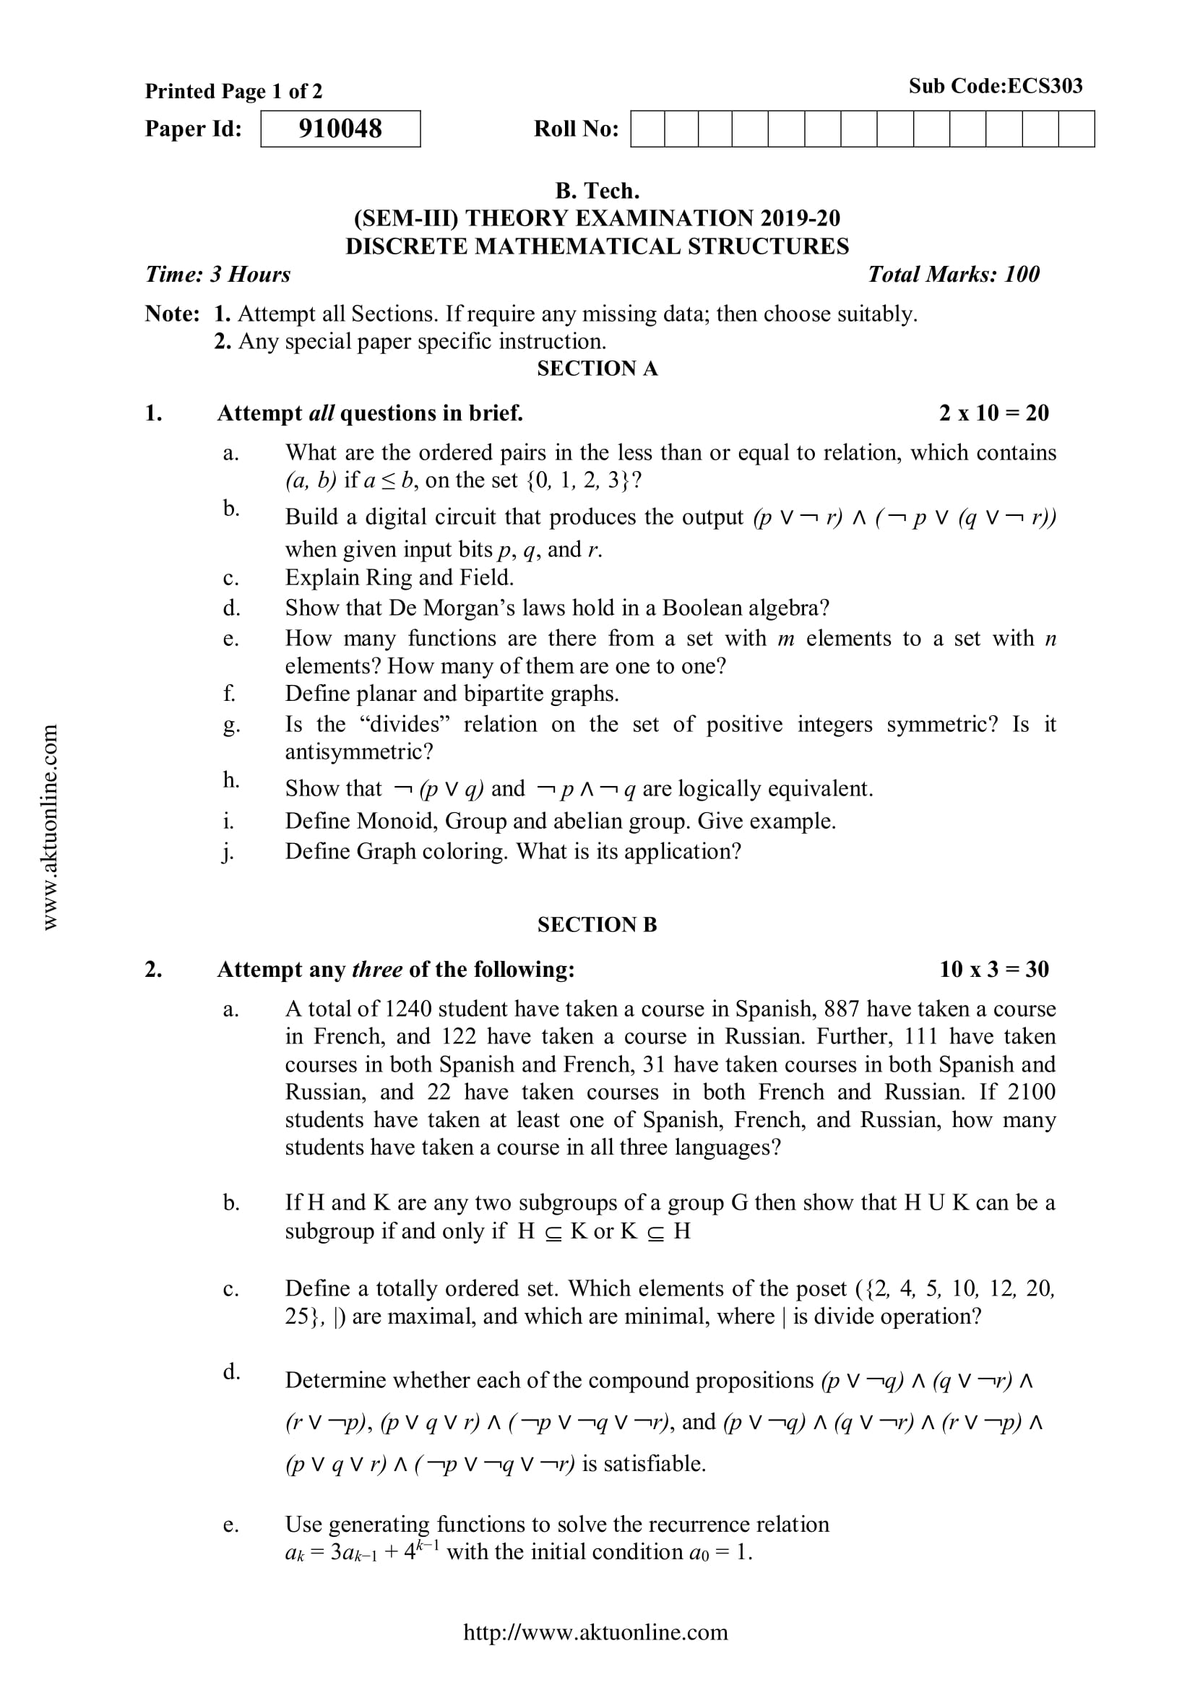
A5 (CO 5)
Mr. Gaurav Singhania, Mr. Bhupendra Kr. KCS-303 (DSTL) Unit 5

Slide 88
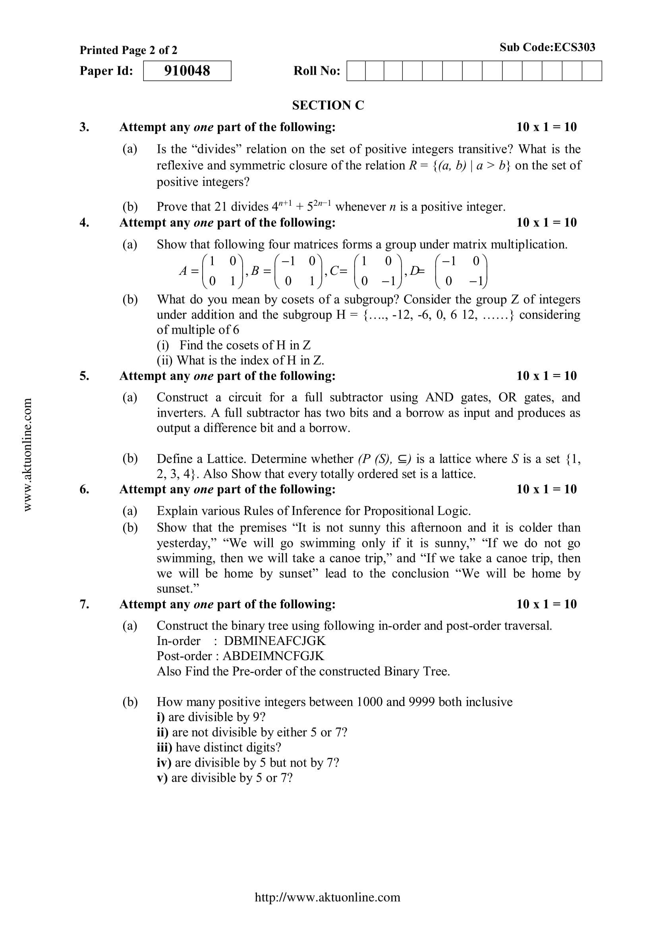
A5 (CO 5)
Mr. Gaurav Singhania, Mr. Bhupendra Kr. KCS-303 (DSTL) Unit 5

Slide 89
A5 (CO 5)
For some more A5 go to the link below.
https://drive.google.com/drive/folders/1LBqJvyWPNRCdAcr9Sag4TzECfnLgRIQn?usp=sharing
Mr. Gaurav Singhania, Mr. Bhupendra Kr. KCS-303 (DSTL) Unit 5

Slide 90
Expected Questions for University Exam(CO 5)
Q1 Find the middle term of (2x - 5)⁶
Q2 What do you mean by Planner graph with example?
Q 3 Find the first four terms each of the following recurrence relation
a_{k} = a_{K-1}+ 3a_{K-2} For all integers k >= 2, a₀ = 1, a₁ = 2
Q 4 Solve the recurrence relation 2a_{r}-5a_{r-1}+2a_{r-2} =0 then find the particular solution a_{o} = 0 and a₁ = 1
Q5 Find N if P ( N, 4) = 42 P (N, 2)
Q 6 Solve the recurrence relation y_{n+2} - Y_{n+1} - 2y_{n} =n²
Q7 Construct a binary tree from the given two Travels
In order 1, 2, 3, 4, 5, 6, 7, 8, 9, 10, 11
Post order 1, 4, 3, 2, 6, 8, 9, 11, 10, 7, 5
Q8 If ^{N}C₅ = 20 ^{N}C₄, find N
Q9 Find the recurrence relation with initial condition for the following
1, 1, 3, 5, 8. 13. 21, …..
Q10 Define Pigeon hole Principle.
Mr. Gaurav Singhania, Mr. Bhupendra Kr. KCS-303 (DSTL) Unit 5

Slide 91
Summary (CO 5)
Now you were able to understand the concepts discrete structures include sets, relation , functions, Algebraic Structure, poset, lattice, Boolean algebra, predicate logic and prepositional laogic, Trees, Graphs, Recurrence Relations and Combinatorics etc.
A tree is an abstract model of a hierarchical structure that consists of nodes with a parent-child relationship.
A graph is a collection of points, called vertices, and lines between those points, called edges.
A recurrence relation is an equation that recursively defines a sequence where the next term is a function of the previous terms (Expressing Fn as some combination of Fi with i<n).
Combinatorics is the branch of mathematics studying the enumeration, combination, and permutation of sets of elements and the mathematical relations that characterize their properties. Mathematicians sometimes use the term "combinatorics" to refer to a larger subset of discrete mathematics that includes graph theory.
The subject enhances one’s ability to develop logical thinking and ability to problem solving.
Mr. Gaurav Singhania, Mr. Bhupendra Kr. KCS-303 (DSTL) Unit 5

Slide 92
References
B. Kolman, R.C. Busby, and S.C. Ross, Discrete Mathematical Structures, 5/e, Prentice Hall, 2004.
Liptschutz, Seymour, “ Discrete Mathematics”, McGraw Hill.
Trembley, J.P & R. Manohar, “Discrete Mathematical Structure with Application to Computer Science”, McGraw Hill
Koshy, Discrete Structures, Elsevier Pub. 2008 Kenneth H. Rosen, Discrete Mathematics and Its Applications, 6/e, McGraw-Hill, 2006.
Mr. Gaurav Singhania, Mr. Bhupendra Kr. KCS-303 (DSTL) Unit 5

Slide 93

Mr. Gaurav Singhania, Mr. Bhupendra Kr. KCS-303 (DSTL) Unit 5

